Slide 1

Gun Violence IN America
By: Amanda Cantu, David Rojas, Jaime Hutton and Jodee Harris

Slide 2
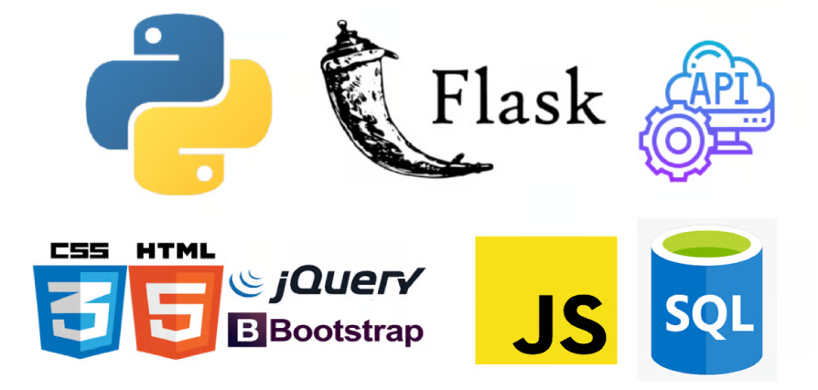
Contents
Purpose
Database
HTML
Python Flask API
JavaScript GeoJson with Leaflet

Slide 3

Purpose
By creating a tool powered by a Python Flask API, HTML/CSS, JavaScript, and a SQLite database, the user can analyze the data of school shootings in the United States from 1999 to 2023.
Considering the importance and reoccurrence of this issue, this tool is meant for public awareness.

Slide 4
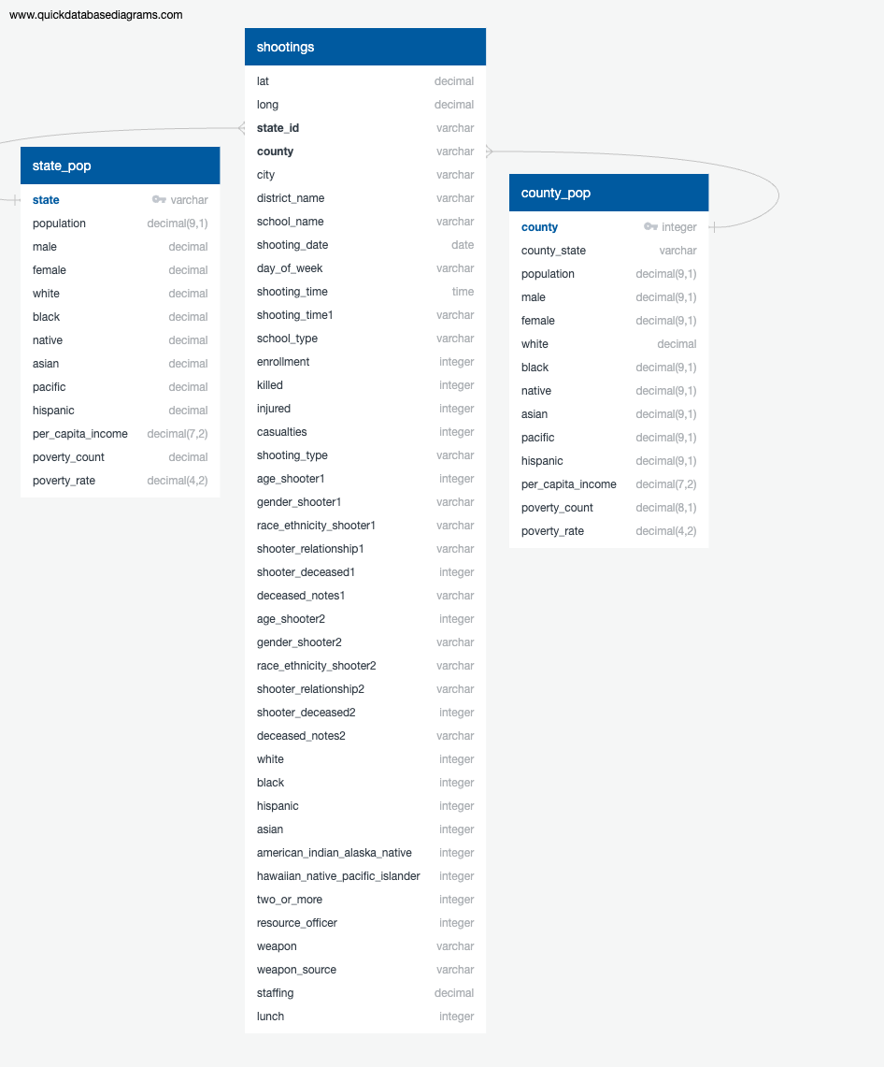
Database
CSV on Shootings and Populations based for our data sets' origins.
SQLite was the database used from SQL Alchemy to transform to API.
The entity relationship diagram (ERD) was used to create a visual of our relationships in our code.

Slide 5

Python Flask API
Importing database and dependencies of Flask.
Breakdown of Tables
Query the API for json format
Creates various routes to be accessed

Slide 6

HTML
Using html code to create a web page to hold the dashboard and maps for our datasets.
Linking each web page to each other for easy maneuvering through out the web pages.

Slide 7

JavaScript GeoJson with Leaflet
Creating tile layer maps on JavaScript to interact with the user.
Using ChartJS Library for different colored markers.
Notes:
Consider talking about:
Barrel
Projectile

Slide 8
Works cited
https://www.vectorstock.com/royalty-free-vector/simple-black-and-white-gun-vector-8614354 (Image- Slide 1)
https://www.upwork.com/services/product/development-it-python-flask-web-application-with-api-in-html-css-javascript-and-bootstrap-1467755780835794944 (Image- Slide 2)

